Slide 1


Paul Nielsen - 11/26/2024

Slide 2

Outline
Executive Summary
Introduction
Methodology
Results
Conclusion
Appendix

Slide 3
Executive Summary
Summary of methodologies
Data Acquisition via API
Data Gathering through Web Scraping
Data Cleaning and Preparation
Exploratory Data Analysis using SQL
Exploratory Data Analysis utilizing Data Visualization
Interactive Visual Analytics using Folium
Predictive Modeling with Machine Learning
Summary of all results
Insights Gained from Exploratory Data Analysis
Dynamic Visualizations Illustrated through Interactive Analytics Screenshots**
Results Derived from Predictive Analytics

Slide 4
Project background and context
SpaceX has revolutionized the aerospace industry with its Falcon 9 rocket, offered at a competitive price of $62 million per launch, significantly undercutting traditional providers that charge over $165 million. This cost advantage stems from SpaceX's innovative approach to rocket reuse, allowing the company to land and refurbish the first stage, thus reducing expenses and increasing launch frequency. As a data scientist at a startup aiming to compete with SpaceX, this project focuses on developing a machine learning pipeline to predict the landing success of the Falcon 9's first stage. By accurately forecasting landing outcomes, we can gain insights into the factors affecting success and establish competitive bidding strategies, thereby enhancing the capabilities of alternative launch providers in a challenging market
Started looking at the following questions for guidance
How can we effectively gather launch data for analysis? This was addressed through the use of the SpaceX API and web scraping techniques to collect relevant data.
What challenges arise in data collection, such as missing values? The process included checking for and filling in missing values to ensure the integrity of the dataset.
How do we categorize and analyze launch success and failure? We established a system for transforming string indicators into categorical variables to facilitate analysis of mission outcomes.
Introduction

Slide 5

Section 1

Slide 6
Methodology
Executive Summary
This structured approach enables a comprehensive analysis of factors influencing Falcon 9 rocket landing success.
Data Collection:
Collected data using SpaceX REST API and web scraping from Wikipedia.
Data Wrangling:
Dropped unnecessary columns and applied one-hot encoding to categorical features.
Exploratory Data Analysis (EDA):
Used visualizations (scatter and bar graphs) and SQL for data analysis.
Interactive Visual Analytics:
Employed Folium and Plotly Dash for interactive visualizations.
Predictive Analysis:
Built and tuned classification models to predict landing outcomes.

Slide 7
Data Collection
Data collection was conducted using a GET request to the SpaceX API.
The response content was decoded as JSON using `.json()` and converted into a pandas DataFrame with `.json_normalize()`.
The data was then cleaned, and missing values were checked and filled where necessary.
Additionally, web scraping was performed from Wikipedia for Falcon 9 launch records using BeautifulSoup.
The objective was to extract launch records as an HTML table, parse the table, and convert it into a pandas DataFrame for further analysis.

Slide 8
Sources
This comprehensive data collection process allows us to gather and analyze targeted information effectively.
SpaceX REST API**: Provides data on rockets, launches, and payload information.
URL: api.spacexdata.com/v4/
Wikipedia: Offers data on launches, landings, and payload information.
URL: Falcon 9 Launch Records

Slide 9

Data Collection – SpaceX API
The GitHub URL of the completed SpaceX project is here.
API Response
Pass to JSON File
Data Transformation
Export Data
Create and Filter a Data Frame
Data Dictionary

Slide 10







Data Collection - Scraping
The GitHub URL of the completed SpaceX project is here.
HTML Response
Pass to BeautifulSoup
Find all tables and Column names
Create a dictionary and add data to the keys
Create and Filter a Data Frame
Export to File

Slide 11

Data Wrangling
Definition: Data wrangling is the process of cleaning and unifying messy datasets for easy access and Exploratory Data Analysis (EDA).
In our analysis of Falcon 9 launch records, we used BeautifulSoup for web scraping to extract data from an HTML table and converted it into a pandas DataFrame. We categorized mission outcomes as follows:
Successful Missions True Ocean, True RTLS, True ASDS
Failed Missions: False Ocean, False RTLS, False ASDS
We transformed these into categorical variables, assigning **1** for success and **0** for failure. Next, we calculated the number of launches per site and analyzed mission outcomes by orbit type. We also created a landing outcome label to facilitate further analysis and visualization. Finally, the cleaned dataset was exported to a CSV file for future use.
The GitHub URL of the completed SpaceX project is here.

Slide 12


EDA with Data Visualization
In our exploratory data analysis (EDA), we utilized various visualization techniques to uncover relationships and trends within the Falcon 9 launch data. The following scatter plots were created:
Flight Number vs. Payload Mass
Flight Number vs. Launch Site
Payload vs. Launch Site
Orbit vs. Flight Number
Payload vs. Orbit Type
Orbit vs. Payload Mass
Tools used:
Scatter plots are effective for illustrating the correlation between two variables, allowing us to observe patterns in the data.
Bar Graphs: Used to compare success rates across different orbit types, illustrating the relationship between numeric and categorical variables.
Line Graphs: Showcased the success rate over the years, highlighting trends and enabling predictions for future launches.
Visualizations
The correlation between flight numbers and launch sites.
The impact of payload on launch sites.
Success rates by orbit type.
Yearly trends in launch success.
These insights enhance our understanding of the data and inform future analyses and predictions.

Slide 13
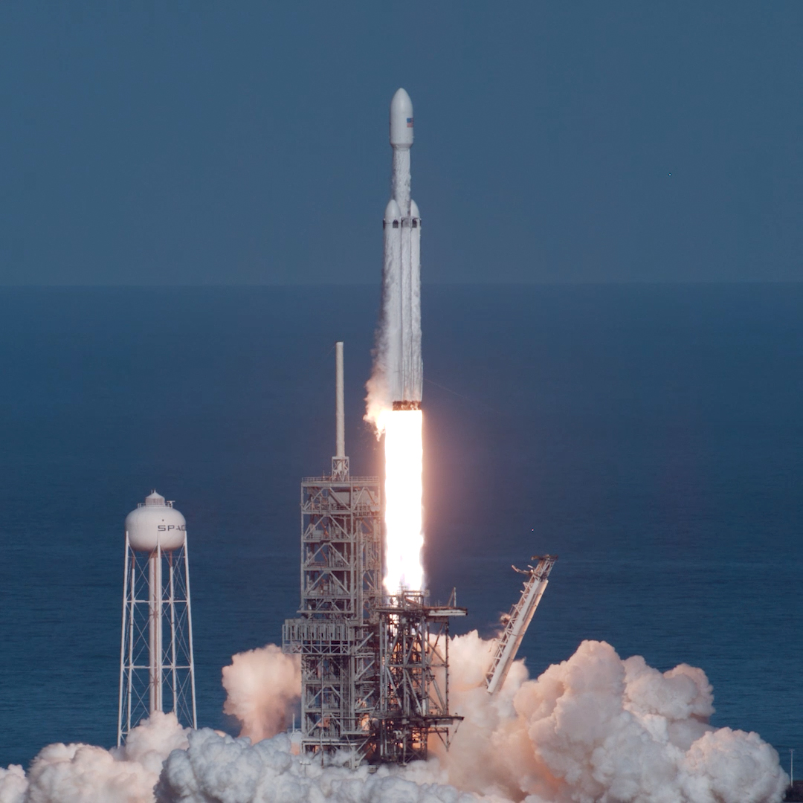
EDA with SQL
In our exploratory data analysis (EDA), we performed various SQL queries to extract key insights from the dataset:
Unique Launch Sites: Displayed names of all unique launch sites.
Filtered Launch Sites: Retrieved 5 records where launch sites begin with 'CCA'.
Total Payload Mass for NASA: Calculated total payload mass for NASA's CRS missions.
Average Payload Mass: Determined average payload mass for booster version F9 v1.1.
First Successful Ground Pad Landing: Listed date of the first successful landing on a ground pad.
Successful Drone Ship Boosters: Identified boosters with successful drone ship landings and payload mass (4000 < mass < 6000).
Mission Outcomes: Listed total successful and failed mission outcomes.
Maximum Payload Mass Boosters: Retrieved names of booster versions with maximum payload mass.
Monthly Failure Outcomes in 2015: Displayed month names, failed drone ship landings, booster versions, and launch sites for 2015.
Ranking Successful Landings: Ranked successful landing outcomes from 04-06-2010 to 20-03-2017 in descending order.
These queries provided valuable insights, revealing patterns critical for further analysis and decision-making.
The GitHub URL of the completed SpaceX project is here.

Slide 14
Build an Interactive Map with Folium
In our analysis, we created an interactive map using Folium to visualize key launch sites and their outcomes:
Map Centering: The Folium map is centered on NASA Johnson Space Center in Houston, Texas.
Markers and Circles:
A red circle marks the NASA Johnson Space Center's coordinates, labeled appropriately.
Red circles at each launch site’s coordinates are also labeled with the site names.
Clustering: We utilized clustering (folium.plugins.MarkerCluster) to group points, displaying multiple pieces of information at the same coordinates.
Landing Outcome Markers:
Successful landings are marked in green, while unsuccessful landings are marked in red (folium.map.Marker, folium.Icon).
Distance Markers: We plotted distances from each launch site to key locations (railways, highways, coastlines, and cities) using lines (folium.PolyLine) for better understanding.
Key Features:
Visualization of Launch Sites: The map allows for easy identification of launch sites and their surroundings, as well as the number of successful and unsuccessful landings.
Launch Outcome Classification: Outcomes are classified as 0 (failure) or 1 (success), helping to identify success rates at various sites.
Distance Calculations: We calculated distances from launch sites to nearby features, answering questions such as:
Are launch sites located near railways, highways, and coastlines?
Do launch sites maintain a certain distance from urban areas?
This interactive map serves as a valuable tool for understanding the spatial relationships between launch sites and their operational contexts.
The GitHub URL of the completed SpaceX project is here.

Slide 15

Build a Dashboard with Plotly Dash
We developed an interactive dashboard using Plotly Dash, integrating various components to enhance data visualization and user interaction:
Dashboard Components
Dropdown Menu: Users can select a specific launch site or view data for all sites (dash_core_components.Dropdown).
Pie Chart: Displays total successes and failures for the selected launch site, providing a clear visual representation of outcomes (plotly.express.pie).
Range Slider: Allows users to filter payload mass within a specified range, enabling focused analysis of payload-related data (dash_core_components.RangeSlider).
Scatter Plot: Illustrates the relationship between success rates and payload mass, highlighting trends across different booster versions (plotly.express.scatter).
Key Insights:
The dashboard effectively visualizes total launches for specific sites and allows users to explore the correlation between launch outcomes and payload mass.
By combining these interactive features, users can gain deeper insights into the performance and characteristics of various launch sites and payloads, fostering informed decision-making in space mission planning.
This dashboard serves as a powerful tool for stakeholders to analyze launch data dynamically, enhancing understanding of key factors influencing mission success.
The GitHub URL of the completed SpaceX project is here.

Slide 16
Predictive Analysis (Classification)
Predictive Analysis in Machine Learning
In our predictive analysis, we followed a systematic approach to build and evaluate machine learning models for launch success prediction:
Data Loading and Preparation
Data Loading: Utilized NumPy and Pandas to load the dataset.
Data Transformation: Transformed the data for analysis.
Data Splitting: Split the dataset into training and testing sets.
Model Building
Model Development: Constructed various machine learning models.
Hyperparameter Tuning: Employed GridSearchCV to tune different hyperparameters for optimal performance
Model Evaluation
Accuracy Metric: Used accuracy as the primary evaluation metric for model performance.
Confusion Matrix**: Plotted the confusion matrix to visualize model predictions.
Model Improvement
Feature Engineering: Enhanced model performance through feature engineering techniques.
Algorithm Tuning: Further refined models to improve accuracy.
Results
*Best Performing Model: Identified the best performing classification model through systematic evaluation.
The GitHub URL of the completed SpaceX project is here.

Slide 17
Results
Exploratory Data Analysis Results
Our exploratory data analysis (EDA) provided valuable insights into the dataset, highlighting key relationships and trends in launch outcomes, payloads, and launch sites.
Interactive Analytics Demo
An interactive dashboard was created to visualize our findings, featuring:
Dropdown Menus for selecting launch sites.
Pie Charts showing success and failure rates.
Range Sliders to filter payload masses.
Scatter Plots illustrating the relationship between success rates and payload mass.
Predictive Analysis Results
The predictive analysis led to a well-tuned machine learning model, achieving:
Identification of the best-performing classification model.
Improved accuracy through hyperparameter tuning and feature engineering.
Visualizations of model performance, including confusion matrices.
These results enhance our understanding of launch success factors and provide actionable insights for future missions.

Slide 18

Section 2

Slide 19

Flight Number vs. Launch Site
Our analysis reveals a compelling trend: across all launch sites, the success rate is on the rise. Notably, the data indicates that as the number of flights increases at a site, so too does the success rate. This pattern is visually represented in our scatter plot, which demonstrates a clear correlation between flight volume and success rates.
However, an intriguing exception emerges with the CCAFS SLC40 site, which exhibits a weaker pattern compared to others. While most sites benefit from increased flight activity leading to higher success rates, CCAFS SLC40 deviates from this trend, prompting further investigation into the factors influencing its performance. This nuanced understanding of launch success dynamics is crucial for optimizing future missions.

Slide 20
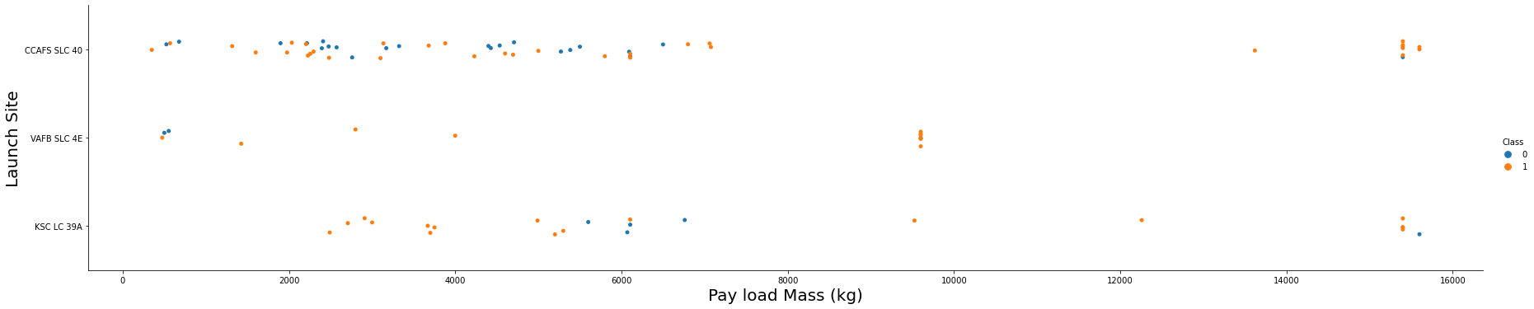
Payload vs. Launch Site
The success of a rocket landing can be influenced by the payload mass, especially depending on the launch site. For example, at Cape Canaveral Air Force Station's SLC-40, a heavier payload generally correlates with a higher success rate. Analysis shows that once the payload exceeds 7,000 kg, the probability of a successful landing significantly increases. However, it's important to note that there isn't a definitive relationship indicating that the launch site itself is directly dependent on the payload mass for overall success rates.

Slide 21
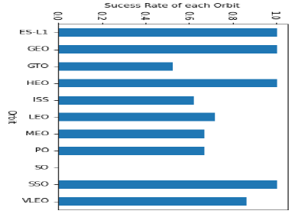
Success Rate vs. Orbit Type
The figure illustrates how different orbital types can affect landing outcomes. Certain orbits, such as SSO, HEO, GEO, and ES-L1, exhibit a 100% success rate, while the SO orbit shows a 0% success rate. However, a closer examination reveals that some of these orbits, like GEO, SO, HEO, and ES-L1, have only a single occurrence in the data, indicating that more data is needed to identify consistent patterns or trends before making any definitive conclusions. From the analysis, it's clear that ES-L1, GEO, HEO, SSO, and VLEO demonstrate the highest success rates, with ES-L1, GEO, HEO, and SSO particularly standing out as the most successful orbits.

Slide 22
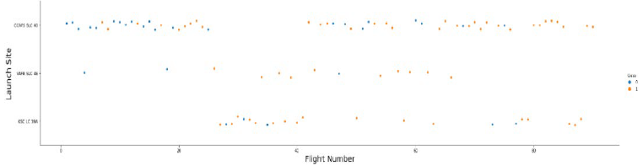
Flight Number vs. Orbit Type
The scatter plot indicates a general trend where an increasing number of flights for each orbit correlates with a higher success rate, particularly in LEO orbit. However, the GTO orbit shows no discernible relationship between flight numbers and success rates. It's important to note that orbits with only one occurrence should be excluded from this analysis, as additional data is necessary for reliable conclusions. Specifically, the success rate for LEO orbit appears to improve with more flights, while GTO does not demonstrate any correlation. It can be inferred that the high success rates of orbits like SSO and HEO may stem from insights gained from previous launches in other orbits. Overall, the data suggests that a greater number of flights at a launch site is associated with an increased success rate.

Slide 23
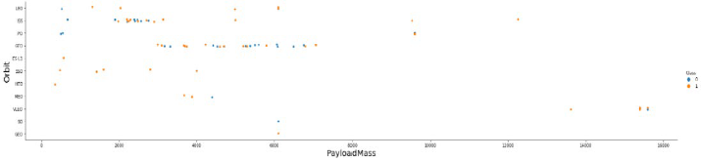
Payload vs. Orbit Type
Heavier payloads positively impact the success rates for LEO, ISS, and PO orbits, while negatively affecting MEO and VLEO orbits. The GTO orbit appears to show no relationship between payload weight and success rates. Additionally, orbits like SO, GEO, and HEO require more data to identify any discernible patterns or trends. The weight of the payload can significantly influence launch success rates in specific orbits; for instance, heavier payloads enhance success in LEO, while reducing payload weight in GTO can lead to improved launch outcomes. Overall, it is evident that heavy payloads are associated with higher success rates for landings in PO, LEO, and ISS orbits.

Slide 24
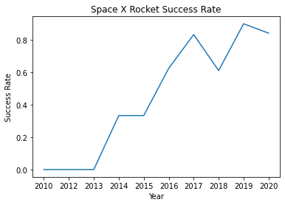
Launch Success Yearly Trend
The figures illustrate a clear upward trend in the success rate of SpaceX rockets from 2013 to 2020. If this trend continues in the coming years, the success rate may steadily rise, potentially reaching a 100% success rate. Since 2013, there has been a consistent increase in the success rate, as evidenced by the plot, which shows that the success rate has continuously improved over this period.

Slide 25
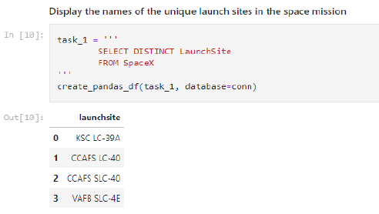
All Launch Site Names
The keyword DISTINCT was utilized to display only unique launch sites from the SpaceX data, effectively eliminating any duplicate entries for the LAUNCH_SITE. This ensures that the data reflects each launch site only once, providing a clearer view of the distinct locations used in the SpaceX launches.

Slide 26
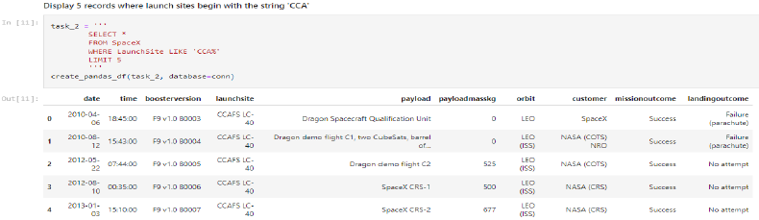
Launch Site Names Begin with 'KSC'
The query was designed to display five records of launch sites that start with "CCA." The WHERE clause, combined with the LIKE operator, filters for launch sites containing the substring "CCA." By using LIMIT 5, the query ensures that only five records are returned from this filtered data, allowing for a focused view of the relevant launch sites.

Slide 27
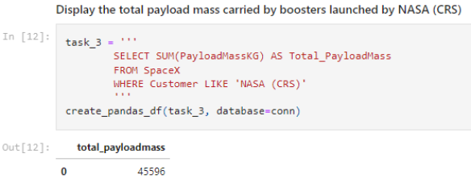
Total Payload Mass
The total payload carried by boosters from NASA was calculated to be 45,596 using the query provided. This query specifically returns the sum of all payload masses associated with NASA as the customer (CRS), allowing for an accurate assessment of the total payload delivered by these boosters.

Slide 28
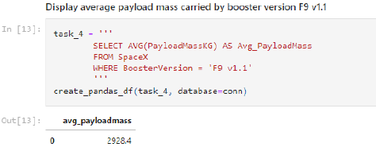
Average Payload Mass by F9 v1.1
The average payload mass carried by the booster version F9 v1.1 was calculated to be 2,928.4. This query computes the average of all payload masses where the booster version includes the substring "F9 v1.1," providing a precise measure of the payload capacity associated with this specific booster version.

Slide 29
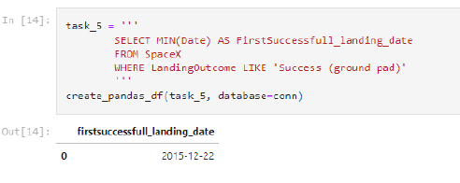
First Successful Ground Landing Date
We utilized the MIN() function to determine the date of the first successful landing on a ground pad, which was observed to be December 22, 2015. The query selects the oldest successful landing by filtering the dataset to include only records where the landing was successful. By applying the MIN function, we identified the record with the earliest date, confirming that the first successful landing outcome occurred on that date.

Slide 30
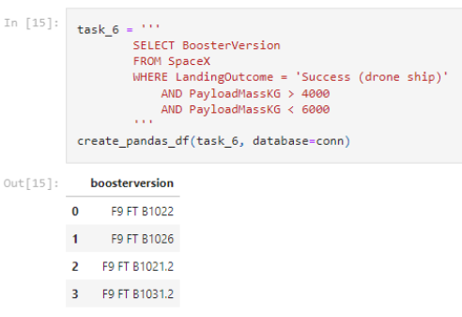
Successful Drone Ship Landing with Payload between 4000 and 6000 Kg
We employed the WHERE clause to filter for boosters that successfully landed on a drone ship, applying the AND condition to specify that the payload mass must be greater than 4,000 kg but less than 6,000 kg. This query returns the booster versions that meet both criteria: a successful landing and a payload mass within the specified range. The use of the WHERE and AND clauses effectively narrows down the dataset to the relevant entries

Slide 31
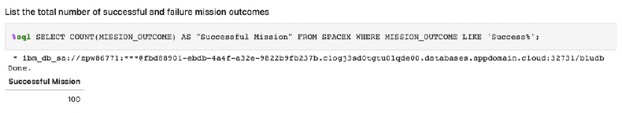
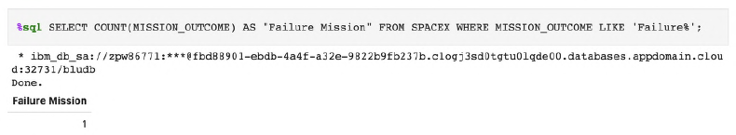
Total Number of Successful and Failure Mission Outcomes
We utilized the wildcard '%' in the WHERE clause to filter for mission outcomes categorized as either a success or a failure. This approach allowed us to analyze the total number of successful and unsuccessful mission outcomes. The first SELECT statement presents subqueries that yield results: the first subquery counts the successful missions, while the second counts the unsuccessful missions. The WHERE clause, combined with the LIKE clause, effectively filters the mission outcomes, and the COUNT function tallies the records that meet the specified criteria.

Slide 32
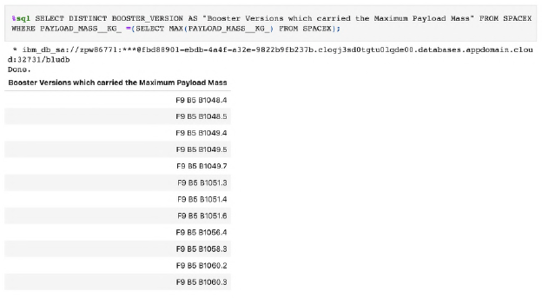
Boosters Carried Maximum Payload
We identified the booster that carried the maximum payload by using a subquery within the WHERE clause in conjunction with the MAX() function. The subquery effectively filters the data to return only the heaviest payload mass. The main query then utilizes the results from this subquery, applying SELECT DISTINCT to return the unique booster versions associated with that maximum payload mass. This method allows us to pinpoint the specific booster responsible for carrying the largest payload.

Slide 33
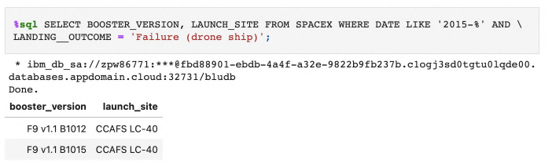
2015 Launch Records
We employed a combination of the WHERE clause, LIKE, AND, and BETWEEN conditions to filter for failed landing outcomes on a drone ship, focusing on their booster versions and launch site names specifically for the year 2015. This query retrieves the month, booster version, and launch site where the landing was unsuccessful and the landing date occurred in 2015. The SUBSTR function processes the date to extract the month and year, with SUBSTR(DATE, 4, 2) identifying the month and SUBSTR(DATE, 7, 4) indicating the year. This comprehensive approach allows us to analyze the specific details of failed landings during that time period.

Slide 34
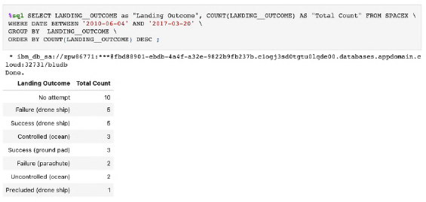
Rank Landing Outcomes Between 2010-06-04 and 2017-03-20
We selected landing outcomes along with the COUNT of those outcomes from the dataset, using the WHERE clause to filter for landing outcomes between June 4, 2010, and March 20, 2010. The query retrieves landing outcomes where the mission was successful and the date falls within the specified range. We then applied the GROUP BY clause to group the results by landing outcome, which allows for a consolidated view of the counts. Finally, the ORDER BY COUNT DESC clause organizes the grouped landing outcomes in descending order, presenting the results from the most to the least frequent landing outcomes.

Slide 35

Section 3

Slide 36
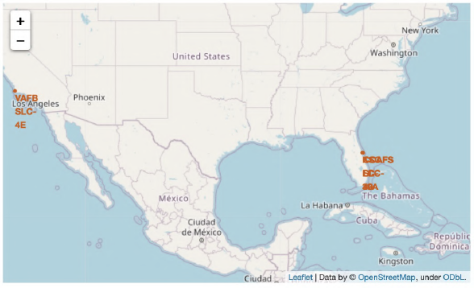
Launch Stations via Folium Map
Indeed, all SpaceX launch sites are strategically located on the coasts of the United States. This positioning allows for safe launch trajectories over water, minimizing risks to populated areas and facilitating recovery operations for boosters. The coastal locations also provide access to favorable conditions for launches, including favorable winds and reduced air traffic.

Slide 37
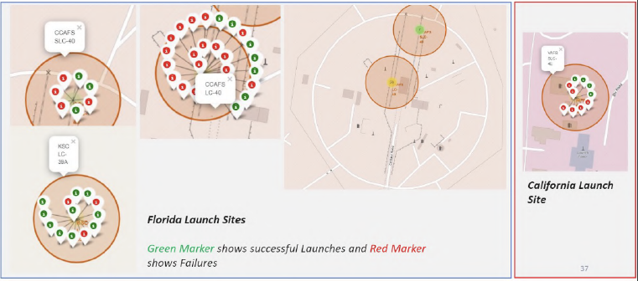
Launch Sites by Color
The green marker indicates successful launches, while the red marker represents unsuccessful launches. Notably, KSC LC-39A exhibits a higher launch success rate compared to other launch sites. This trend highlights the effectiveness and reliability of operations at KSC LC-39A, making it a key site for SpaceX's launch activities. The visual representation of the markers clearly illustrates the performance of various launch sites.

Slide 38
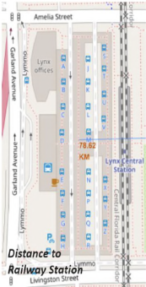
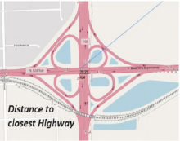
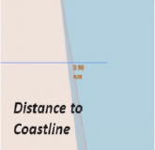
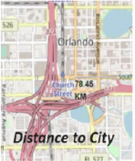
Launch Site Distances to Landmarks
The inquiries regarding CCAFS SLC-40 reveal the following:
Is CCAFS SLC-40 in close proximity to railways? Yes.
Is CCAFS SLC-40 in close proximity to highways? Yes.
Is CCAFS SLC-40 in close proximity to coastline? Yes.
Does CCAFS SLC-40 keep a certain distance away from cities? No.
This information indicates that CCAFS SLC-40 is well-connected by transportation routes, such as railways and highways, and is near the coastline, but it does not maintain a significant distance from urban areas.

Slide 39

Section 4

Slide 40
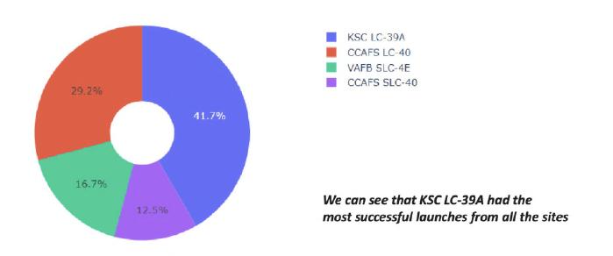
Launch Site Success Rates
The success percentages of various launch sites reflect their reliability and effectiveness in executing successful missions, highlighting the overall performance trends across the board.

Slide 41
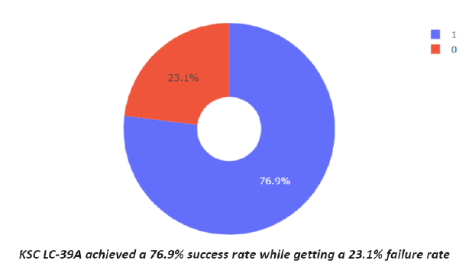
Launch Success Ratios, particularly KSC LC-39A
When analyzing launch sites by success rates, KSC LC-39A stands out with the best success rate of 76.9%. This translates to a failure rate of 23.1%. The high success rate indicates that KSC LC-39A has been particularly effective in executing launches, outperforming all other sites. This performance reinforces its reputation as a reliable location for SpaceX's launch operations.

Slide 42
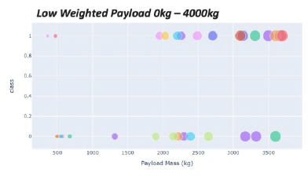
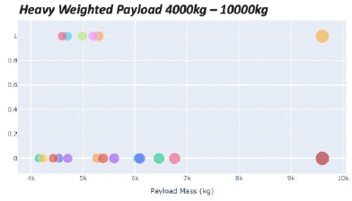
Payloads vs Launch Outcomes
The success rate for low-weighted payloads is higher than that of heavier payloads, indicating that lighter payloads tend to achieve better launch outcomes. This trend is consistent across all observed data, as the success rates for low-weighted payloads consistently surpass those of heavy-weighted payloads.
Low Weight < 4000kg High Weight >= 4000kg

Slide 43
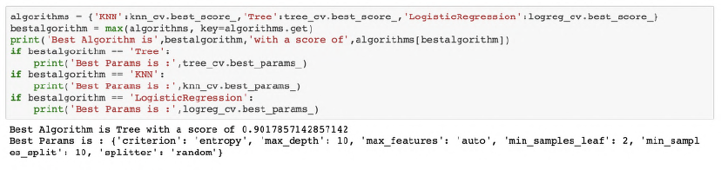
Classification Accuracy
The classification accuracy analysis reveals that the Tree Algorithm stands out as the best-performing model, achieving the highest classification accuracy among the tested algorithms. While all methods demonstrated similar performance in the accuracy test, additional test data could help further refine the comparison. Ultimately, the decision tree classifier emerges as the model with the highest classification accuracy, making it a strong choice for classification tasks.

Slide 44
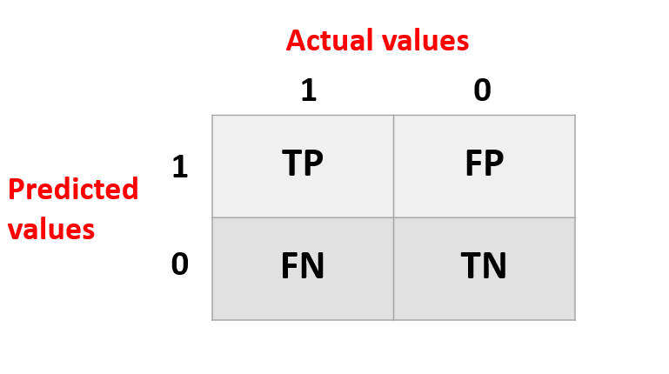
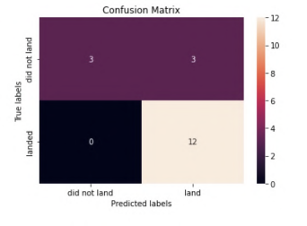
Confusion Matrix
The confusion matrix for the decision tree classifier indicates that the model effectively distinguishes between different classes. However, a significant issue arises with false positives, where unsuccessful landings are incorrectly classified as successful. Since the test accuracies across the models are equal, their confusion matrices are also identical, reinforcing that the primary challenge for these models is the occurrence of false positives. This highlights the need for further refinement to reduce misclassifications and improve overall reliability.

Slide 45
Conclusions
Optimal Machine Learning Model: The Tree Classifier Algorithm is identified as the best approach for this dataset, demonstrating superior training accuracy compared to other models.
Payload Performance: Low-weighted payloads (defined as 4000 kg and below) consistently outperform heavy-weighted payloads, highlighting their effectiveness in achieving successful launches.
Increasing Success Rate: Since 2013, SpaceX's launch success rate has shown a positive trend, indicating a steady improvement aligned with the increase in launch experience, suggesting potential for continued success in the future.
Launch Site Effectiveness: KSC LC-39A has achieved the highest success rate of any launch site, with an impressive 76.9% success rate, underlining its reliability for missions.
Orbit Success Rates: The SSO orbit stands out with a perfect 100% success rate across multiple missions, while other successful orbits include GEO, HEO, and ES-L1. This suggests various factors contribute to mission success, including launch site and prior launch experience.
Impact of Launch Frequency: A correlation exists between the number of launches at a site and the success rate, indicating that increased launch frequency can enhance overall performance.
Data Limitations: Current data does not fully explain the variance in success rates among different launch sites. Additional atmospheric or contextual data could provide further insights into these discrepancies.
Overall Mission Criteria: The success of a mission is influenced by multiple factors, including payload mass and orbit type. Understanding these relationships can help optimize future launches.

Slide 46
Appendix
All code, screenshots and data to create this presentation is located on GitHub.

Slide 47


